Slide 1
US Presidential Election Analysis
By Cameron Mangione, Jamil Ditter, Alex Song

Slide 2
Agenda
Introduction
Theoretical Background
Methodology
Exploratory Data Analysis
Results + Analysis
Random Forest Classifier
Single + Multiple Linear Regression
Conclusion / Key Takeaways

Slide 3
Introduction: Goal of the project
Determine whether socioeconomic or demographic variables can be used to predict state-level presidential elections outcomes.

Slide 4
Theoretical Background
Two different predictive models:
Random tree classification model
Linear regression model
Utilize machine learning models to estimate outcomes based on explanatory variables

Slide 5
Explanatory Variables
The percentage of residents who had received a bachelor’s degree
The median household income of the population
The percentage of the population aged 18-24
The percentage of the population aged 25-44
The percentage of the population aged 45-64
The percentage of the population aged 65+
The percentage of voter participation
The median age of the population
The unemployment rate of the population

Slide 6
Random Forest Model
Classification model that creates and fits a multitude of decision trees with a training algorithm selecting random samples from training data with replacement.

Slide 7
Linear Regression Model
Models relationships between explanatory variables and a dependent response variable through the use of linear predictor functions whose unknown model parameters are estimated from the data.

Slide 8
Data Methodology
Factors and datasets were compiled & sorted by year and state.
Filtered for the range of 2000-2024 election years.
Created our two overall models for these datasets.

Slide 9
Random Forest Methodology
Measured on democrat victory.
Training data sorted into an 80-20 split.
Metrics of accuracy score + classification report for additional info

Slide 10
Linear Regression Methodology
Predicted either percentage of Democrat or Republican votes.
Single input model
Unemployment Rate
Median Income
Voting participation
Ages 18-24
Age 65+
Multiple regression model
Reduced Model
Swing State Model
Scaled Model

Slide 11
Multiple Linear Regression Breakdown
Created reduced models
Democrat: Unemployment rate, median income, bachelor’s degree percentage, 18-24 age population, 65+ age population, and voter participation.
Republican: Same as Democrat without bachelor’s degree percentage.
Scaled reduced models
Swing State models
Predictors used: unemployment rate, percentage of the population aged 18-24, and percentage of the population aged 65+.

Slide 12
Computational Results: Exploratory Data Analysis
Correlation Heatmaps
Box plots
Notes:
Our EDA included computing Correlation Heatmaps and analyzing Box plots.

Slide 13
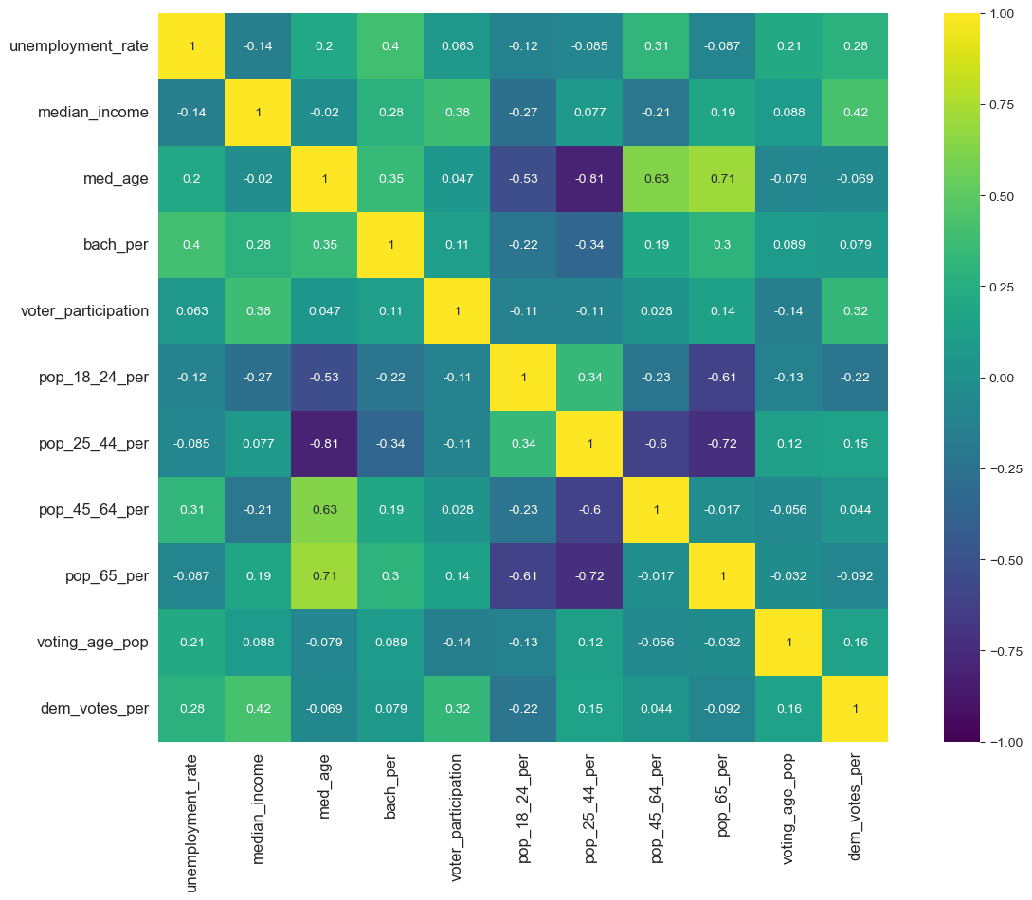
Democrat Correlation Heatmap
Notes:
The heatmap showed the strongest correlations with voting percentages. For Democrat voting percentage, the strongest positive correlation was with median income (0.42) and voter participation (0.32).

Slide 14
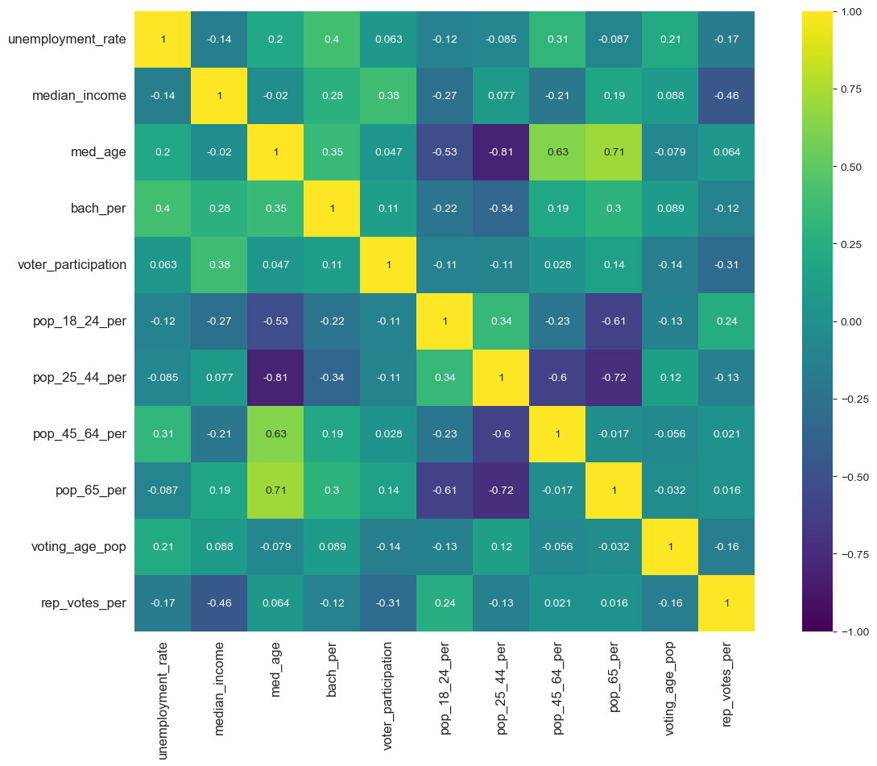
Republican Correlation Heatmap
Notes:
Republican voting percentage showed quite opposite, the strongest negative correlations were found in median income (–0.46) and voter participation rate (–0.31). This inverse relationship is expected when comparing the two major parties.

Slide 15
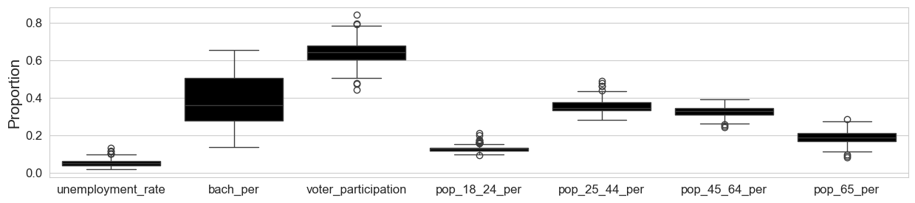
Boxplots
Notes:
The boxplots revealed many high and low outliers across almost all our predictor variables, exception for the bachelor's degree percentage (bach_per). These correlations shown in the heatmaps and the characteristics revealed by the boxplots were the main drivers for us to conclude that our data was suitable for further modeling using both random forest classification and linear regression models.

Slide 16
Random Forest Model: National Level
Republican class ("False"),
Precision score of 0.800
Democratic class ("True"):
Precision of 0.875.
The model achieved an overall accuracy of 0.833.
Notes:
The accuracy score of 0.833 is considered fairly strong for this model. We found that the Democratic prediction was slightly more precise than the Republican prediction.

Slide 17
Random Forest Model: National Level Analysis
Democrat was more precise than Republican in the model
Accuracy score of 0.833 is quite good for this model.
National random forest model effective for answering the goal of our project.
Notes:
This indicated that the National random forest model was quite effective for answering the goal of our project. In short, the three most important predictors identified by this model were voter participation, unemployment rate, and median income.

Slide 18
Random Forest Model: Swing and State Level
Swing state model (Wisconsin, Pennsylvania, Ohio, Michigan, and Florida):
Accuracy score of 0.5
Single state model (Pennsylvania):
Accuracy score of 0.5
Notes:
When we narrowed our focus, the model's effectiveness dropped dramatically. They showed accuracy score of 0.5.
The Swing state model (Wisconsin, Pennsylvania, Ohio, Michigan, and Florida) resulted in a low accuracy score of 0.5..
The Single state model (Pennsylvania) also showed a low accuracy score of 0.5.

Slide 19
Random Forest Model: Swing + State Level Analysis
Both models accuracy scores of 0.5 show that the model was not able to definitively predict which factors could predict a Democrat or Republican win
Swing + state level random forest model was not effective for answering the goal of our project.
Notes:
The accuracy scores of 0.5 for both the swing and single-state models demonstrate that the model was essentially guessing and was not able to predict which factors determined a Democrat or Republican win. We concluded that focusing on individual states significantly reduced the amount of data available, which means rendering the random forest model is ineffective for these state-level predictions.

Slide 20
Single Input Regression Results
Single input regression models investigated:
Median income,
Unemployment rate,
Voter participation, and the
18-24 voting population percentage
65+ voting population percentages
Mean absolute errors for these variables were each within around 7-9%
Root mean squared error being in a range of about 10-12%.
Of these single variables, the Republican median income predictor showed the lowest RMSE and MAE at 10.3% and 7.5%, respectively.
Notes:
For our single input, we picked the five main variables from our exploratory data analysis that seemed to have the strongest relationships.

Slide 21
Single Input Regression Analysis
All predictors were statistically significant except Republican 65+ voting population percentage.
Of these single variables, the Republican median income predictor showed the lowest RMSE and MAE at +-10.3% and +-7.5%, respectively.
In both cases, these errors are both high given and represent wide error ranges.
These ranges make sense given that we are assessing single inputs for linear regression.

Slide 22
National Multiple Linear Regression Results
Model | Target | R2 | Adj. R-squared | MAE
Full Model | Democratic Votes | 0.445 | 0.426 | 0.0588
Full Model | Republican Votes | 0.403 | 0.383 | 0.0618
Reduced Model | Democratic Votes | 0.390 | 0.380 | 0.0649
Reduced Model | Republican Votes | 0.324 | 0.314 | 0.0685

Slide 23
National Multiple Linear Regression Full Model Analysis
The full model showed an R-Squared value of 0.445(moderate strength) for Democrat.
The full model showed an R-Squared value of 0.403(moderate strength) for Republican.
Moderate strength due to this analysis not being a completely comprehensive list of predictors for voting percentage.
Mean Absolute errors for each were around +-5-7%, which showed improvement over single inputs.
Notes:
Our analysis did not cover all factors that impact democrat and Republican voting percentage.

Slide 24
Multiple Linear Regression Reduced Model Analysis
The full model showed an R-Squared value of 0.390(moderate strength) for Democrat.
The full model showed an R-Squared value of 0.324(weak strength) for Republican.
Reduction in R-Squared values is due to removing some statistically significant variables.
The mean absolute error also increased for both Democrat and Republican as a result of the R-Squared increase.

Slide 25
Multiple Linear Regression Swing States Model Results
Model | Target | R2 | Adj. R-squared | MAE
Full Model | Democratic Votes | 0.656 | 0.391 | 0.015
Full Model | Republican Votes | 0.691 | 0.454 | 0.013
Reduced Model | Democratic Votes | 0.556 | 0.501 | 0.028
Reduced Model | Republican Votes | 0.238 | 0.143 | 0.034

Slide 26
Multiple Linear Regression Swing States Full Model Analysis
The Swing State model showed an R-Squared value of 0.656(strong) for Democrat.
The full model showed an R-Squared value of 0.691(strong) for Republican.
The R-Squared strength increase was likely due to reducing the dataset down to five states rather than looking at the entire dataset.
Mean Absolute errors for each were around +-1.3-1.5%, which while a huge improvement over the National model, is primarily due to the reducing our dataset.

Slide 27
Multiple Linear Regression Swing States Reduced Model Analysis
The Swing State reduced model showed an R-Squared value of 0.5564 (strong) for Democrat, but reduced compared to Swing full model.
The Swing State reduced model showed an R-Squared value of 0.2384(weak) for Republican, dropping by 45.29% compared to the full swing state model.
The R-Squared strength decrease was likely due to reducing the categories down to 3 factors (unemployment, and 18-24 + 65+) for Republican and Democrat.
Mean Absolute errors between +-2.75%-3.35% showed larger errors compared to the full State analysis.

Slide 28
Multiple Linear Regression Scaled Model Results
Model | Target | R2 | Adj. R-squared | MAE
Scaled Model | Democratic Votes | 0.656 | 0.391 | 0.015
Scaled Model | Republican Votes | 0.691 | 0.454 | 0.013
Notes:
Mean 0 and a standard deviation, and we measure how a coefficient changes by 1 standard deviation.
For our scaled models, we found that for Democrat voting percentage, holding all other variables constant, we would expect to see:
For unemployment rate, a 4.01% increase in democratic voting percentage.

Slide 29
Democrat Scaled Model Coefficients
Democrat Predictors | Dem Scaled Model Coefficients
Unemployment Rate Normalized | 0.0401
Median Income Normalized | 0.0507
Bachelor or higher population percentage Normalized | -0.0200
65+ Population percentage Normalized | -0.0307
Voter Participation Normalized | 0.0191
18-24 Population Percentage Normalized | -0.0283
Notes:
For our scaled models, we found that for Democrat voting percentage, holding all other variables constant, we would expect to see:
For unemployment rate, a 4.01% increase in democratic voting percentage.

Slide 30
Republican Scaled Model Coefficients
Republican Predictors | Rep Scaled Model Coefficients
Unemployment Rate Normalized | -0.0193
Median Income Normalized | -0.0466
65+ Population percentage Normalized | 0.0290
Voter Participation Normalized | -0.0177
18-24 Population Percentage Normalized | 0.0290
Notes:
And for Republican voting percentage, holding all other variables constant, we would expect to see:
For unemployment rate, a 1.93% decrease in Republican voting percentage.

Slide 31
Multiple Linear Regression Scaled Model Analysis
Overall, in these models, median income had the greatest impact on both Democrats and Republicans,
With Democrats seeing a 5.07% percentage point increase
and Republicans seeing a 4.66% percentage point decrease in percentage of votes.

Slide 32
Key Takeaways
Median income was the strongest factor for both Democrat and Republican voting percentages in our data.
National random forest model was able to predict election results with an 83% accuracy score.
Unemployment rate, median income, bachelor degree percentage, voter participation, and all population age ranges percentages (18-24, 25-44, 45-64, 65+) had statistically significant results in our dataset.
Our multiple linear regression model produced an error rate between approximately +-5-7% from the true voting percentage total for each group on average.
Our swing state models showed that unemployment rate was statistically significant, with it being the only statistically significant predictor for the Democrat model, while the Republican model also included the population percentages.
Notes:
Overall we believe that these models were effective in achieving our goal ofbuild a model that could predict election results based on key socioeconomic factors.

Slide 33
References
Bureau, US Census. “Voting and Registration in the Election of November 2024.” Census.Gov, US Census, 24 Apr. 2025, www.census.gov/data/tables/time-series/demo/voting-and-registration/p20-587.html.
Bureau, US Census. “CPS Historical Time Series Tables.” Census.Gov, US Census, 25 Aug. 2025, www.census.gov/data/tables/time-series/demo/educational-attainment/cps-historical-time-series.html.
Dataverse, Harvard. “1976-2020-President.TAB - U.S. Presidential Elections.” Harvard Dataverse, 2025, dataverse.harvard.edu/file.xhtml?fileId=10244938&version=8.0.
Download center, StatsAmerica. StatsAmerica Download Center, 2025, www.statsamerica.org/downloads/default.aspx.
Economic Data, Federal Reserve. “Federal Reserve Economic Data.” MEDIAN HH INCOME BY STATE 1984 -2023 (Updated Periodically) - FRED\ALFRED - St. Louis Fed, FRED, 2025, fredaccount.stlouisfed.org/public/datalist/8534/.
MIT Election Data and Science Lab, 2018, "County Presidential Election Returns 2000-2024", https://doi.org/10.7910/DVN/VOQCHQ, Harvard Dataverse, V16, UNF:6:NKTy7eW9uEWX4imXpPxf5g== [fileUNF]
Statista, Statista. “Educational Attainment Distribution in the United States from 1960 to 2022 .” Statista, 2025, www.statista.com/statistics/184260/educational-attainment-in-the-us/.

